Slide 1
IMP POINTS
HPC

Slide 2
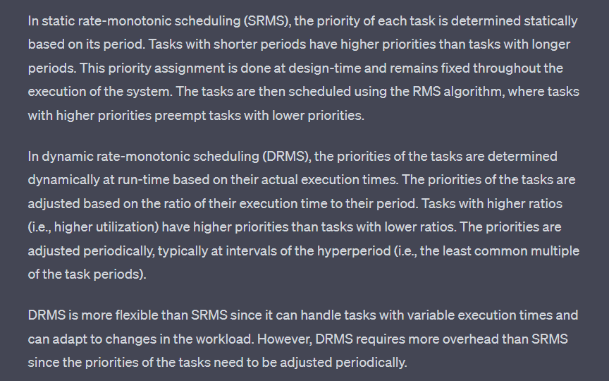
Why we prefer higher no of VM in clouds instead of using same VM ?
LEC 20
Ans . Computation cost in cloud is not linear to freq It is proportional to f raise to power 1.5-1.7 so more than linear so at higher freq cost higher in combining then separate.
Ans. Computation Power
Which constraint doesnot allow playing at 4k in old mobiles
Static rate monitor scheduling is not good as compared to dynamic rate monitor scheduling

Slide 3
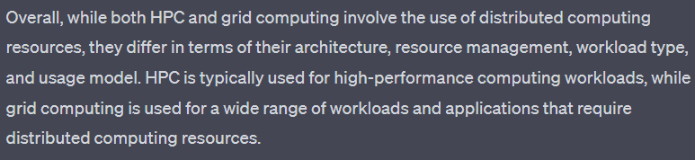
Hpc vs grid
Diff between HPC and cloud
Self owned vs User and owner seperated

Slide 4
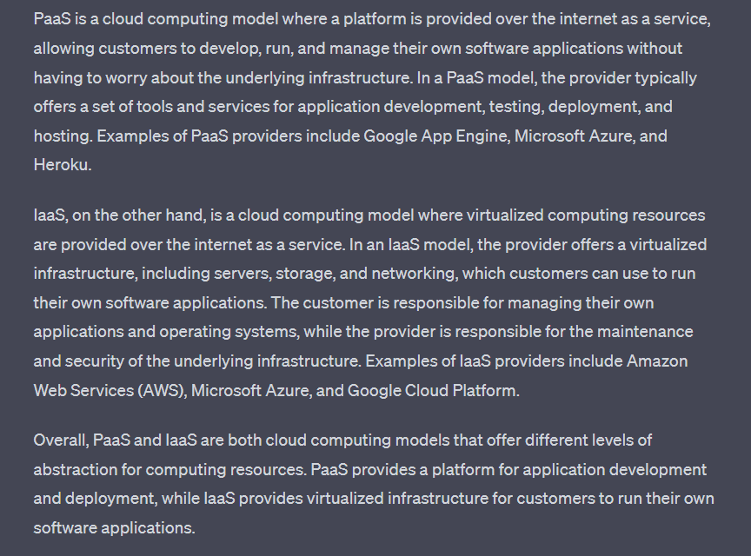

Slide 5
PaaS :
It is a cloud computing model where a platform is provided over the internet as a service, allowing customers to develop, run, and manage their own software applications without having to worry about the underlying infrastructure.
A simple example of PaaS is a web development platform like WordPress or Wix.
IaaS:
IaaS stands for Infrastructure as a Service. It is a cloud computing model where virtualized computing resources, such as servers, storage, and networking, are provided over the internet as a service.
A simple example of IaaS is Amazon Web Services (AWS), which provides a cloud-based infrastructure for running and managing virtual servers. With AWS, users can create and manage virtual servers over the internet, without having to worry about the underlying physical hardware.
SaaS :
SaaS stands for Software as a Service. It is a cloud computing model where software applications are provided over the internet as a service, rather than being installed and run locally on a user's computer.
A simple example of SaaS is an email service like Gmail or Yahoo Mail. These services provide users with email access over the internet, without requiring them to install any software on their local computer.

Slide 6
